Slide 1
Symbiotic Relationships
Directions: There will be 5 examples of organisms displaying a symbiotic relationship (mutualism, parasitism, or commensalism).
You will be given TWO minutes to decide which relationship it is and then write it on your dry erase board and hold up for me to see.
Be ready to discuss WHY you chose that relationship.

Slide 2
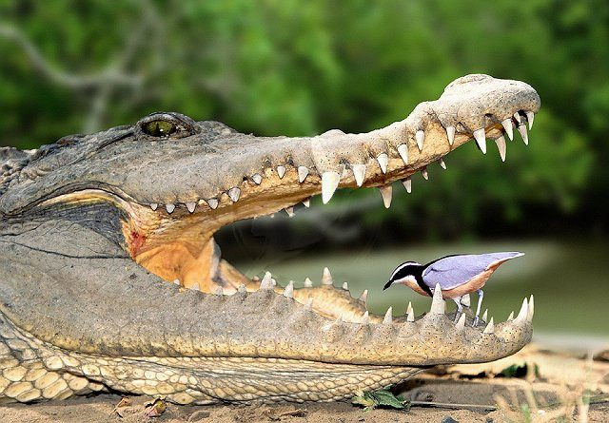
1.
The Nile crocodile opens its mouth to permit the Egyptian plover (a bird) to feed on any leeches attached to its gums. The crocodile does not harm the plover.
Mutualism
Notes:
Mutualism

Slide 3
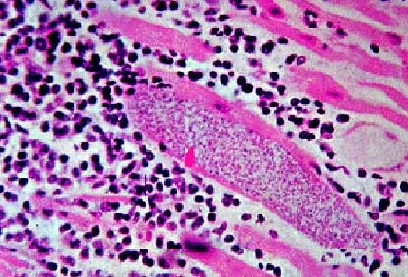
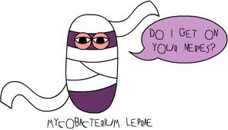
2.
Mycobacterium leprae is a bacterium that takes up residence in the Schwann cells (part of nerve cells in humans). The bacterium receives nourishment. This bacterium eventually triggers the host to produce an autoimmune attack on the cells that damages and leads to the cell’s destruction. The resulting loss of sensation makes it difficult to avoid injury to the extremities.
Parasitism
Notes:
Parasitism.

Slide 4
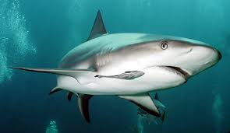
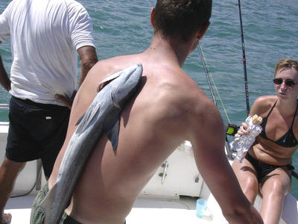
3.
The remora is a bony fish that has a modified dorsal fin. The fin has been modified into a sucker with which it forms a temporary attachment to the shark. When the shark feeds, the remora picks up scraps of food. The shark makes no attempt to prey on the remora.
Commensalism
Notes:
Commensalism. Second picture: no symbiotic relationship (neither benefit nor harmed)

Slide 5
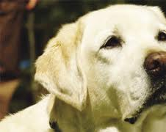
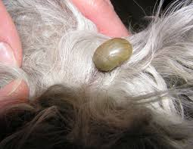
4.
Ticks require blood meals to complete their complex life cycles. Ticks are vectors (transmitters) of diseases for humans and animals. Ticks can transmit disease to many hosts and act as vectors when pathogens in their saliva and mouth secretions get into the host's skin and blood.
Parasitism
Notes:
Parasitism. Tell them my tick story with my dog.

Slide 6
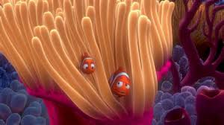
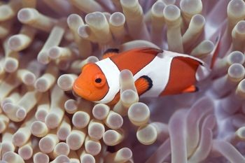
5.
The clownfish attracts prey for the sea anemone to hunt and feed on. It also cleans the anemone by eating up the dead tentacles and algae that settles on it. Clownfish also provide protection from polyp-eating fish. In turn, the sea anemone feeds the clownfish with scraps or leftovers from its meals. It also provides protection to the clownfish from predators due to it’s venomous tentacles. The clownfish is not harmed by their tentacles because it is coated with mucus on its scales protecting it.
Mutualism
Notes:
Mutualism

