Slide 1
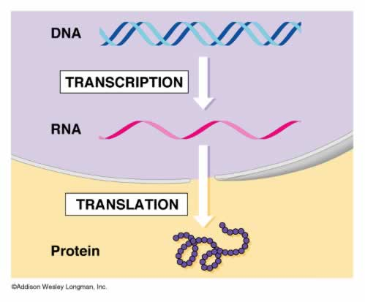
Transcription and Translation
Essential Question- How is information moved between nucleic acids and proteins?

Slide 2
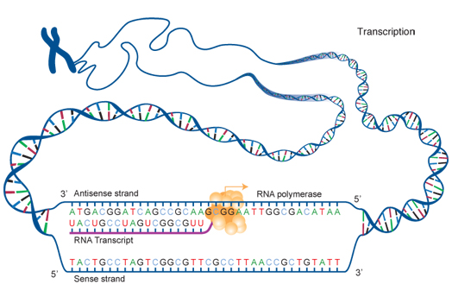
Transcription is…
The process of how a section of DNA is copied into the complimentary sequence of RNA

Slide 3
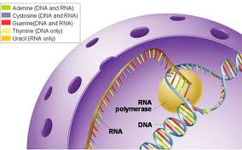
1st step of gene expression (turning DNA sequence into functional molecules)
Occurs in the nucleus of eukaryotes

Slide 4
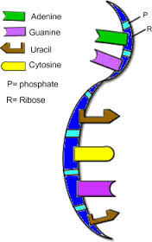
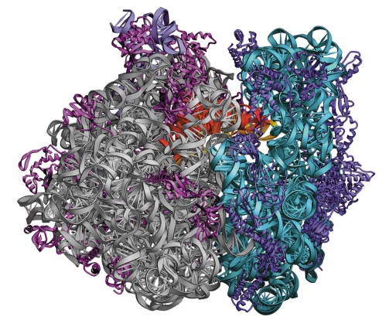
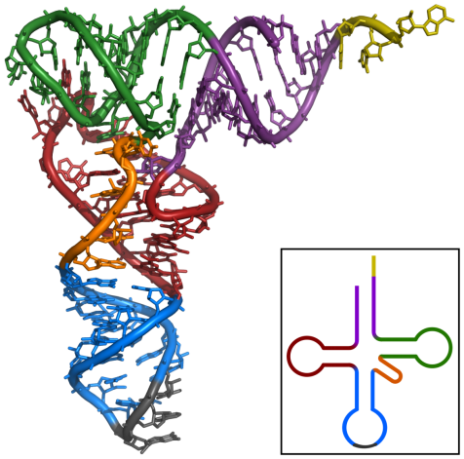
Messenger RNA (mRNA) - Short pieces of RNA that carry messages from
the DNA to the rest of the cell, instructions for making proteins
Ribosomal RNA (rRNA) - make up ribosomes, the organelle that
synthesizes proteins
­­­­­­­Transfer RNA (tRNA) - transfers the amino acids to the ribosomes

Slide 5
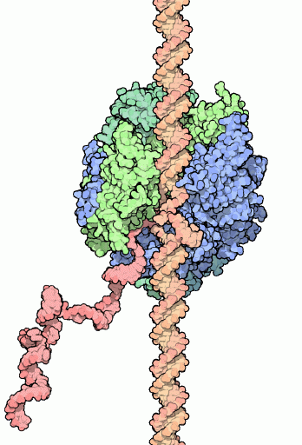
RNA is made by RNA polymerase that links together nucleotides AND opens the DNA helix

Slide 6
Steps of Transcription
Initiation- RNA polymerase binds to and opens the DNA
Elongation- RNA strand is made
Termination- RNA polymerase comes off the DNA and the DNA helix closes
These are the same steps as DNA replication

Slide 7
Promoter region- Area of DNA that RNA polymerase attaches to
RNA polymerase binds to the promoter on the DNA strand and opens DNA double helix

Slide 8
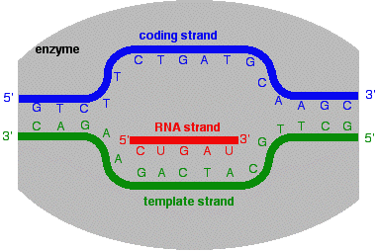
RNA polymerase makes new RNA strand in the 5’→3’
Template strand- DNA strand used as a pattern for RNA synthesis

Slide 9
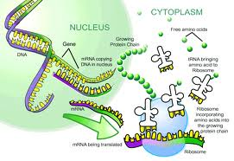
At the end of transcription, mRNA moves from the nucleus to the cytoplasm
Translation occurs at a ribosome and makes a new protein

Slide 10
RNA molecule is released by RNA polymerase and moves to the cytoplasm
RNA polymerase comes off the DNA
DNA double helix closes
Cytoplasm

Slide 11
Regulation of Transcription
Promoter Strength- Some promoters are more attractive to RNA polymerase and produce more DNA
Activators- Proteins bind to the promoter region of DNA and recruit RNA polymerase faster
Repressors - Proteins bind to promoter on DNA and stop the enzyme from starting transcription

Slide 12
Translation
The process of ribosomes decoding an mRNA molecule to make a specific protein

Slide 13
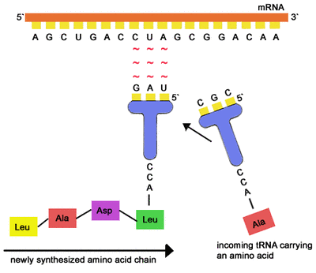
Codon- 3 bases that code for an amino acid on an mRNA
tRNA (transfer RNA) – RNA molecule that brings free amino acids to the ribosome
Anticodon- 3 bases on the tRNA which pairs with the mRNA temporarily

Slide 14
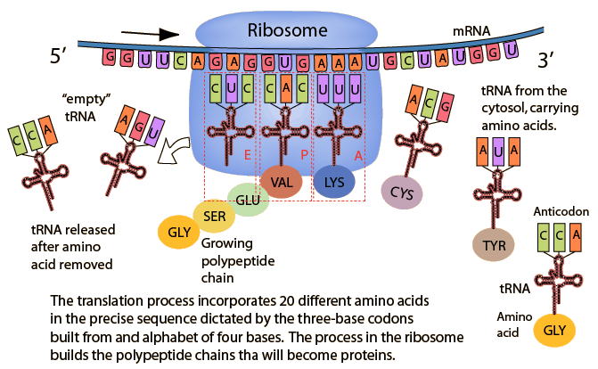
Steps of Translation
1. mRNA moves through the ribosome
2. tRNA with the complimentary anticodon binds to the mRNA codon
3. Ribosome links together the amino acids and releases the empty tRNA
4. Ribosome moves over 3 bases
(Steps 2-4 repeat until entire mRNA sequence has been read)
5. When the ribosome reaches a stop codon, the new protein is released and the ribosome releases the mRNA

Slide 15
How many codons are there?
4
x
4
x
4
=
64 possible different codons
61 codons for amino acids and 3 stop codons
Most amino acids have several codons
Remember- There are 20 different amino acids!

Slide 16
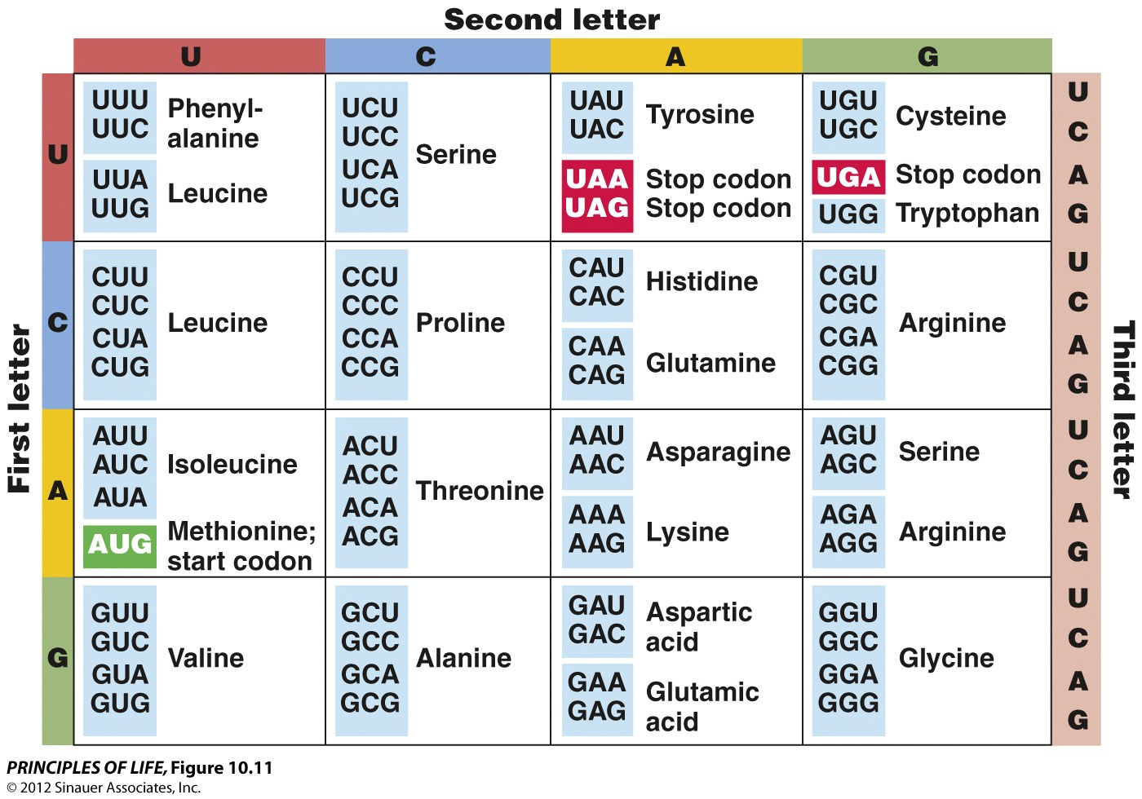
Using a codon chart
2. Find the column for the second base of the codon
1. Find the row for the first base of the codon
3. Find the row for the third base of the codon
Example: AGU
makes serine

Slide 17
DNA Sequence- TAC GGG CTA ACG ATC Write the complimentary RNA sequence.
RNA Sequence- AUG CCC GAU UGC UAG Determine the protein sequence.
Protein Sequence- ___________ ___________ ____________ _____________
Methionine Proline Aspartic Acid Cysteine

