Slide 1
Organelle Function Posters
Make a poster that presents the following information:
Cell Function
Organelles involves
Description of HOW each organelle is involved
An illustration related to your topic

Slide 2
Photosynthesis & Cellular Respiration
Essential Question: How do photosynthesis and cellular respiration compare?

Slide 3
What is the equation for photosynthesis?
6CO₂ + 6H₂O ^{light energy}→ C₆H₁₂O₆ + 6O₂
carbon dioxide + water ^{light energy} → glucose + oxygen
What are the reactants of photosynthesis?
What are the products of photosynthsis?

Slide 4
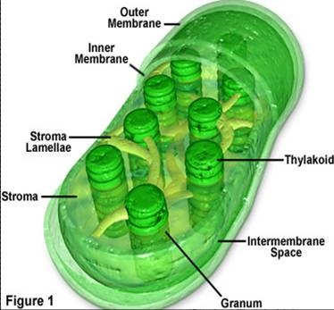
In which organelle does photosynthesis take place?
In the chloroplast!

Slide 5
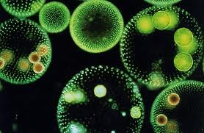
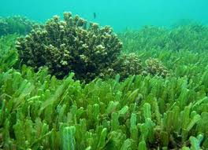
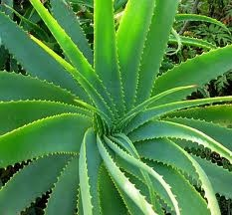
In which organism does photosynthesis take place?
Autotrophs!

Slide 6
What is Cellular Respiration?
The process that releases energy stored in foods.
It involves the breakdown of glucose molecules to release energy that cells need to function.

Slide 7
What is the chemical equation for cellular respiration?
What are the reactants of cellular respiration?
What are the products of cellular respiration?

Slide 8
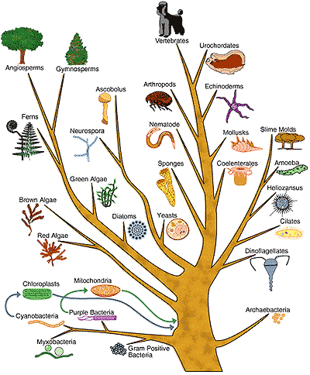
In which organism does cellular respiration take place?
All of them!

Slide 9
During cellular respiration, cells break down food molecules to produce ATP. Cells use the energy in ATP to carry out processes.
Energy is released when a phosphate group is removed.
Energy is stored when a phosphate group is added.

Slide 10
How do the products and reactants of photosynthesis and respiration compare?
Photosynthesis:
6CO₂ + 6H₂O ^{light energy}→ C₆H₁₂O₆ + 6O₂
Cellular Respiration
C₆H₁₂O₆ + 6O₂ → 6CO₂ + 6H₂O

Slide 11
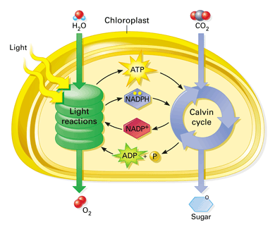
Light reactions and Dark reactions (Calvin cycle) in a chloroplast
Page 209 in your textbook

Slide 12
