Slide 1
Pedigree Charts
The family tree of genetics

Slide 2
Overview
What is a pedigree?
  Definition
  Uses
Constructing a pedigree
  Symbols
  Connecting the symbols
Interpreting a pedigree

Slide 3
What is a Pedigree?
A pedigree is a chart of the genetic history of family over several generations.
Scientists or a genetic counselor would find out about your family history and make this chart to analyze.

Slide 4
Constructing a Pedigree
Symbols
  Female =
  Male =

Slide 5
Connecting Pedigree Symbols
Examples of connected symbols:
  Married Couple
  Siblings

Slide 6
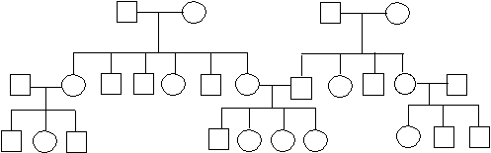
Example
What does a pedigree chart look like?
How many males?
How many females?

Slide 7
Symbols in a Pedigree Chart
Affected
Carrier
Deceased

Slide 8
Interpreting a Pedigree Chart
Determine if the pedigree chart shows an autosomal or X-linked disease.
  If most of the males in the pedigree are affected the disorder is X-linked
  If it is a 50/50 ratio between men and women the disorder is autosomal

Slide 9
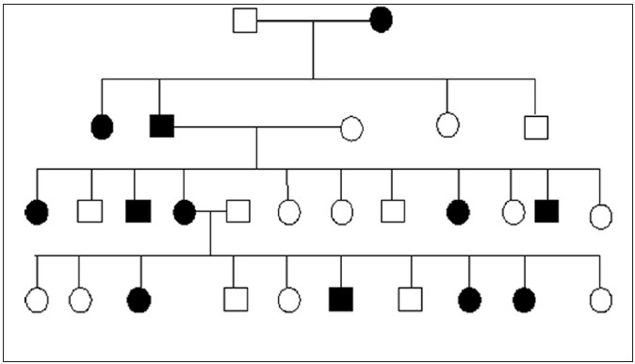
Example of Pedigree Charts
Is it Autosomal or X-Linked?

Slide 10
Answer
Autosomal

Slide 11
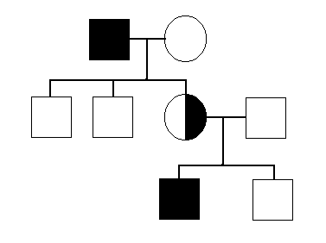
Example of Pedigree Charts
Is it Autosomal or X-Linked?

Slide 12
Answer
X-Linked

Slide 13
Interpreting a Pedigree Chart
Determine whether the disorder is dominant or recessive.
  If the disorder is dominant, one of the parents must have the disorder.
  If the disorder is recessive, neither parent has to have the disorder because they can be heterozygous.

Slide 14
Example of Pedigree Charts
Dominant or Recessive?

Slide 15
Answer
Dominant

Slide 16
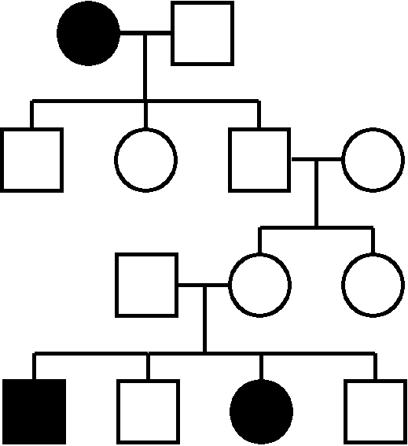
Example of Pedigree Charts
Dominant or Recessive?

Slide 17
Answer
Recessive

Slide 18
Summary
Pedigrees are family trees that explain your genetic history.
Pedigrees are used to find out the probability of a child having a disorder in a particular family.
To begin to interpret a pedigree, determine if the disease or condition is autosomal or X-linked and dominant or recessive.

