Slide 1
NonMendelian Genetics

Slide 2
Incomplete Dominance
If individuals display a trait that is intermediate between the two parents, the pattern of inheritance is called incomplete dominance

Slide 3
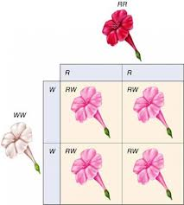
Incomplete Dominance

Slide 4
Codominance
If two alleles are expressed at the same time, the pattern of inheritance is called codominance.

Slide 5
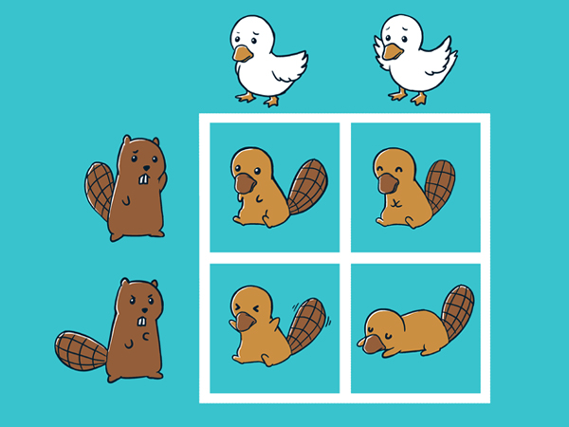
Codominance

Slide 6
Multiple Alleles
Multiple alleles is a condition in which more than two alleles exist for a trait.

Slide 7
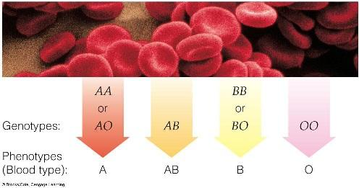
Multiple Alleles

Slide 8
Polygenic Traits
Traits that are controlled by two or more genes.

Slide 9
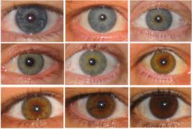
Polygenic Traits

Slide 10
Sex-Linked Genes
Sex linkage is the situation in which the gene for the trait is carried on only the X (23rd) chromosome. Therefore, a man (XY) would only have one gene for this trait, but a woman (XX) would have two genes for the trait since she has two X chromosomes (homologous pair #23).

Slide 11
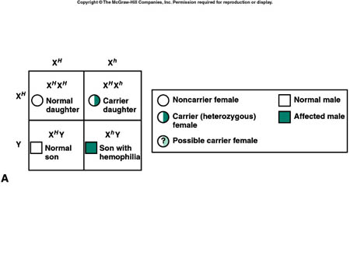
Sex-Linked Genes

