Slide 1
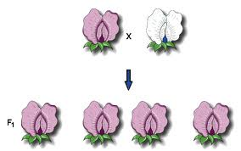
If we know the genetics of parents, can we predict what their offspring will look like?
Objective: predict possible outcomes of various genetic combinations

Slide 2
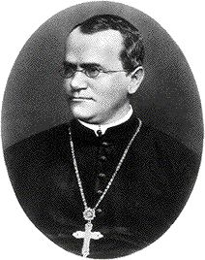
Gregor Mendel: The father of genetics
Austrian monk who studied how traits were passed on in pea plants
He described the principles of genetics long before DNA or genes were understood
Video

Slide 3
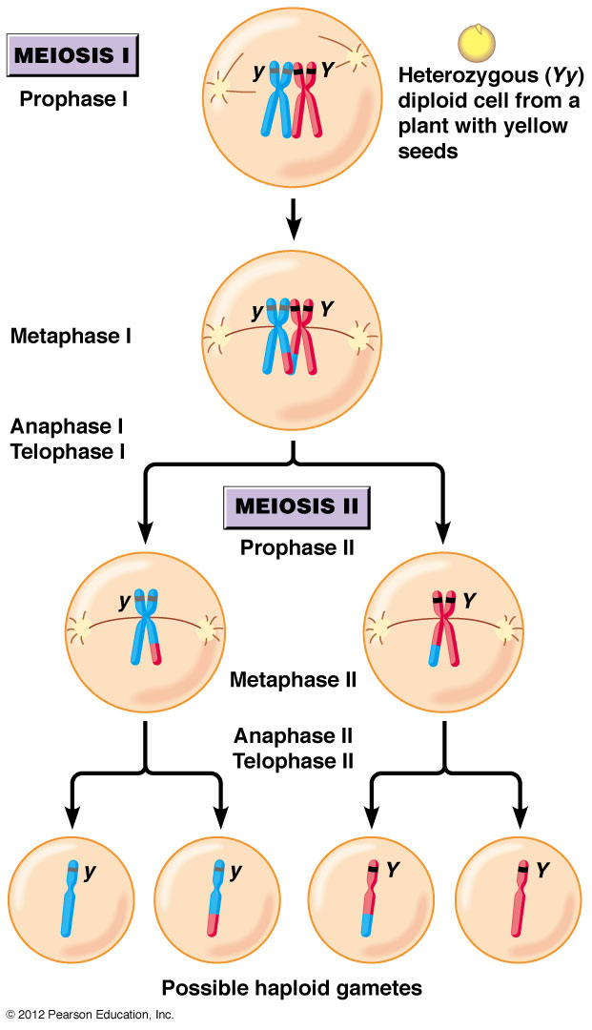
Predicting genetics and traits
Each parent passes on _________ of their genes to their offspring
half
Which 1/2 each parent gives to their offspring is random; known as __________________ __________________
Law of Segregation

Slide 4
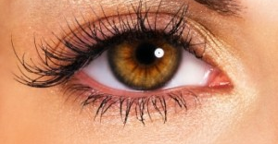
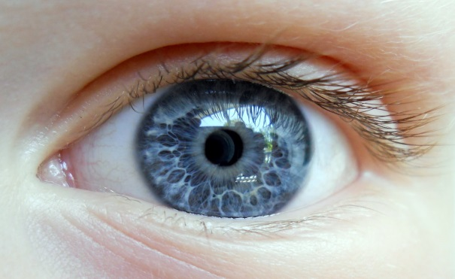
Predicting genetics and traits
______________- the combination of genes an organism has
Genotype- Bb
Genotype
Homozygous- _________________ __________________
Heterzygous- ____________________________________
Having the same alleles
Having different alleles
Genotype- bb

Slide 5
Predicting genetics and traits
______________ genes cover up ____________ genes
Dominant
Recessive
______________- Physical traits of organism, determined by genes
Phenotype

Slide 6
Punnett Squares
_______________________- a chart used to predict possible outcomes of genetic crosses
Shows all possible outcomes of a genetic cross and the likelihood of each outcome
Parents genotype are on ____________________________
Possible offspring genotypes go _________________________
Punnett Square
the outside of the grid
Inside the grid
Parent Genotype
Offspring
Genotypes
Parent Genotype

Slide 7
Punnett Squares
Each parent passes on _________________________ so one letter goes in each parent spot
Carry each allele down or across the grid
Example- A hamster homozygous for brown eyes mates with a hamster homozygous for blue eyes. Brown eyes are dominant to blue eyes
BB x bb
one allele
B B
b b

Slide 8
Punnett Squares
Each parent passes on _________________________ so one letter goes in each parent spot
Carry each allele down or across the grid
Example- A hamster homozygous for brown eyes mates with a hamster homozygous for blue eyes. Brown eyes are dominant to blue eyes
BB x bb
one allele
B B
b b
Bb
Bb
Bb
Bb

Slide 9
Punnett Squares
Genotype of offspring: _______________________
Phenotype of offspring: _______________________
One trait punnett squares- Monohybrid Cross
Bb
Brown eyes
Brown eyes are dominant to blue eyes
B B
b b
Bb
Bb
Bb
Bb

Slide 10
Punnett Squares
Punnett Squares
Can be done with several traits
Example-Two pea plant heterozygous for seed color (Yy) and flower color (Cc) are mated. Describe the offspring.
YyCc x YyCc
_________________________________________- traits are transmitted to offspring independently of one another.
Foil genotype to get possible gamete combinations
Y y C c
Possible gametes____________________________________
Can be done with several traits
Example-Two pea plant heterozygous for seed color (Yy) and flower color (Cc) are mated. Describe the offspring.
YyCc x YyCc
_________________________________________- traits are transmitted to offspring independently of one another.
Foil genotype to get possible gamete combinations
Y y C c
Possible gametes____________________________________
Law of Independent Assortment
YC
yC
Yc
yc

Slide 11
Punnett Squares
Genotypic Ratio: Number of different possible genotypes
Example- Eye color: B-Brown, b- blue; Blue is recessive to brown
Genotypic Ratios: BB:Bb:bb________________
Phenotypic Ratios: Brown eyes: Blue eyes ________________
1:2:1
3:1
B B
b b
Bb
Bb
Bb
Bb

