Slide 1
Enzymes
Identify and Investigate the role of enzymes.

Slide 2
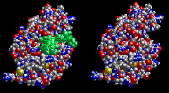
What type of organic molecule is an enzyme?
Enzymes are proteins that act as biological catalysts.

Slide 3
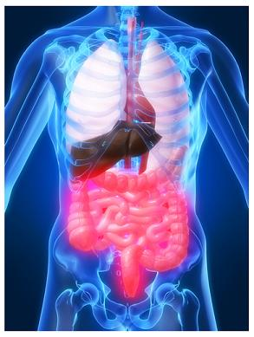
What is a biological catalyst?
A catalyst that is used within the body of organisms to help with life functions.

Slide 4
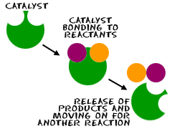
What is a catalyst?
A compound that speeds up the rate of a chemical reaction, but is not used up in the reaction.
Can be used over and over

Slide 5
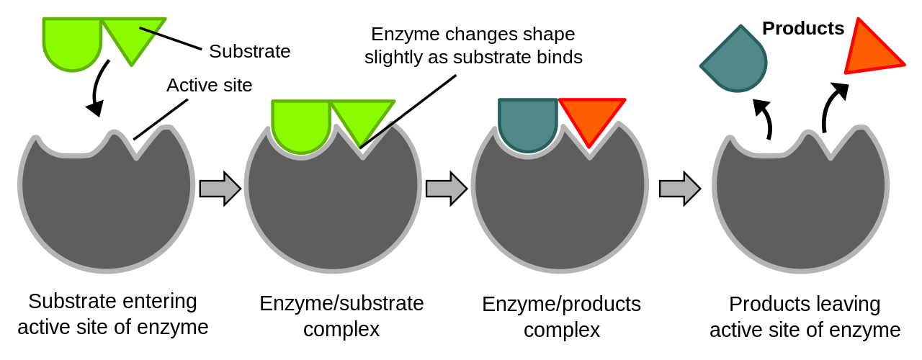
How do enzymes work?
Enzymes work by lowering activation energy
Enzymes chemically recognize, bind and modify substrates.

Slide 6
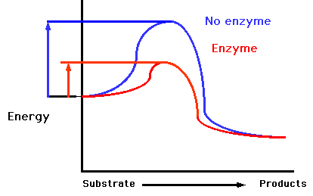
What is activation energy?
The amount of energy required for a reaction to occur.

Slide 7
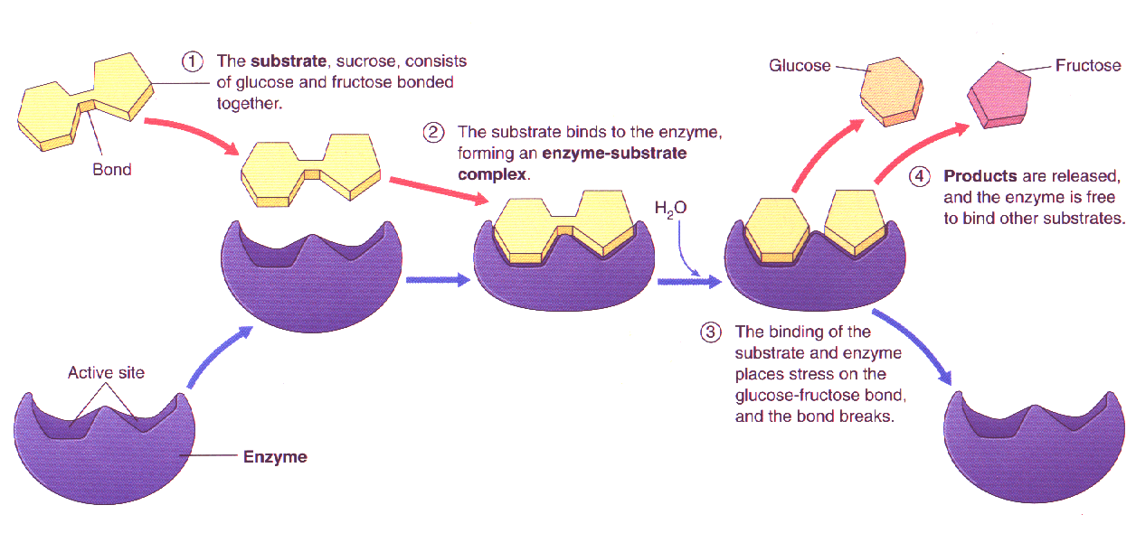

Slide 10
Enzyme Action!

Slide 11
Enzyme Action!

Slide 12
Enzyme Action!

Slide 13
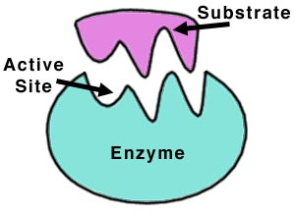
How is an enzyme’s shape related to its function?
Enzymes are highly specific. They only catalyze one chemical reaction, having a specific substrate that they can bond with.
ENZYME ACTION – can occur two ways:
1. Lock and Key model – the substrate molecule has a specific 3-dimensional shape that allows it to fit into the specific 3-D shape of an enzyme’s active site. Both enzyme and substrate already exist in these shapes.
2. Induced Fit model – An interaction between the enzyme and substrate induces or changes the shape of the molecules to produce a suitable fit.

Slide 14
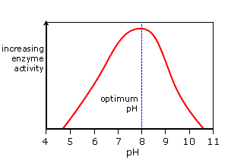
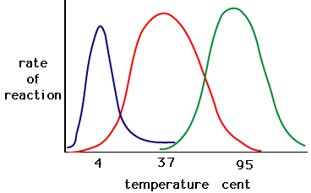
Factors that affect Enzyme Activity
Temperature
pH
Substrate Concentration
All enzymes operate within a narrow range of the above factors.

