Slide 1
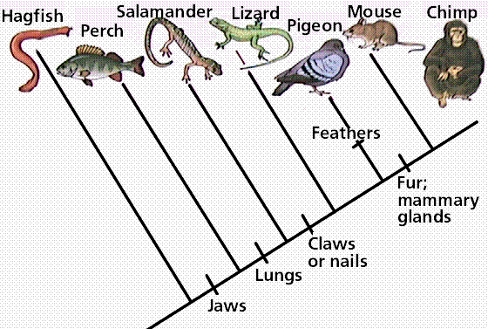
Cladograms

Slide 2
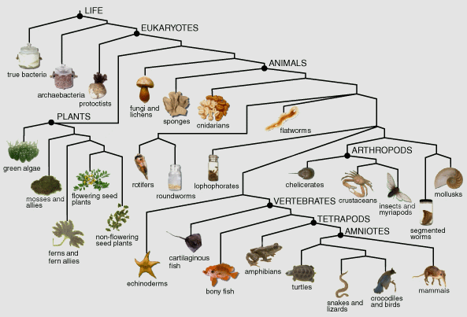
What is a cladogram?
A cladogram shows evolutionary relationships between groups of living things. It is like a family tree for species.

Slide 3
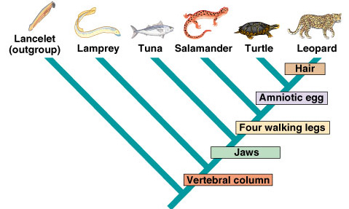
How do you read a cladogram?
The closer two species are on the cladogram, the more closely they are related. This means they evolved apart more recently.
Sometimes a cladogram will also list the characteristics that make two groups or organisms different.
Everything past this point has four walking legs!

Slide 4
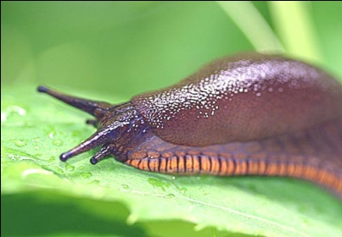
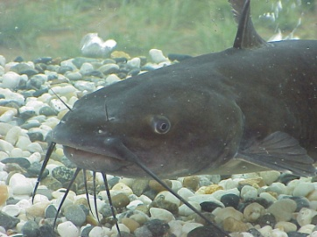
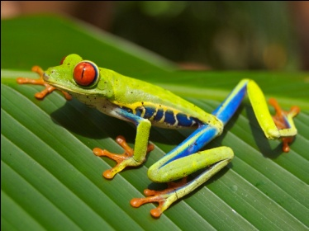
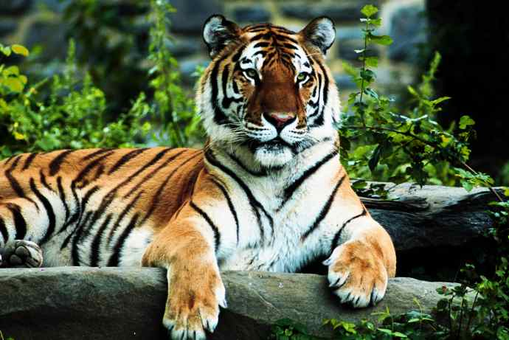
How do you make a cladogram?
Let’s make a cladogram that includes slugs, catfish, frogs, tigers, and humans.
1. Make a table of some adaptations that the organisms share, and some that are unique. For example:
 | Cells | Backbone | Legs | Hair | Thumbs
Slug | X
Catfish | X | X
Frog | X | X | X
Tiger | X | X | X | X
Human | X | X | X | X | X

Slide 5
How do you make a cladogram?
2. Make a Venn diagram, placing the animals in groups to illustrate those characteristics which different animals have in common.
Cells: Slug
Backbone: Catfish
Legs: Frog
Hair: Tiger
Thumbs: Human

Slide 6
How do you make a cladogram?
3. Draw your cladogram. Assume that organisms with more of the traits evolved later, so they go on the right.
TIGER
HUMANS
FROGS
CATFISH
SLUGS

Slide 7
How do you make a cladogram?
4. You can then add in when the different traits probably evolved.
TIGER
HUMANS
FROGS
CATFISH
THUMBS
HAIR
SLUGS
LEGS
BACKBONE
CELLS

Slide 8
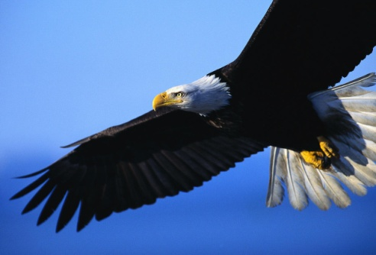
Question??
Where would you add in eagles?
TIGER
HUMANS
FROGS
CATFISH
THUMBS
HAIR
SLUGS
LEGS
BACKBONE
CELLS

